Slide 1
Computational Physics (Lecture 18)
PHY4061

Slide 2
Programming Using MPI
Message passing is a widely-used paradigm for writing parallel applications.
For different hardware platforms, the implementations are different!
To solve this problem, one way is to propose a standard.
The required process started in 1992 in a workshop.
Most of the major vendors, researchers involved.
Message passing interface standard, MPI.
https://www.mcs.anl.gov/mpi-symposium/slides/david_w_walker_25yrsmpi.pdf

Slide 3
The main goal stated by MPI forum is:
“to develop a widely used standard for writing message passing programs. As such the interface should establish a practical, portable, efficient, and flexible standard for message passing”.
Other goals are:
To allow efficient communication (memory to memory copying, overlap of computation and communication).
To allow for implementations that can be used in heterogenous environments,
To design an interface that is not too different from current practice, such as PVM, Express.

Slide 4
The MPI standard is suitable for developing programs for distributed memory machines, shared memory machines, networks of workstations, and a combinations of these.
Because the MPI forum only defines the interfaces and the contents of message passing routines, everyone may develop his own implementation.
MPICH will be introduced here
Developed by Argonne National Laboratory/Mississippi State University.

Slide 5
The basic structure of MPICH
Each MPI application can be seen as a collection of concurrent processes. In order to use MPI functions, the application code is linked with a static library provide by the MPI software package.
The library consists of two layers. The upper layer comprises all MPI functions that have been written hardware independent.
The lower layer is the native communication subsystem on parallel machines or another message passing system, like PVM or P4.

Slide 6
P4 offers less functionality than MPI, but supports a wide variety of parallel computer systems.
The MPI layer accesses the P4 layer through an abstract device interface.
So all hardware dependencies will be kept out of the MPI layer and the user code.

Slide 7
Processes with identical codes running on the same machine are called clusters in P4 terminology.
P4 clusters are not visible to an MPI application.
In order to achieve peak performance, P4 uses shared memory for all processes in the same cluster.
Special message passing interfaces are used for processes connected by such an interface.
All processes have access to the socket interface.
Standard for all UNIX machines.

Slide 8
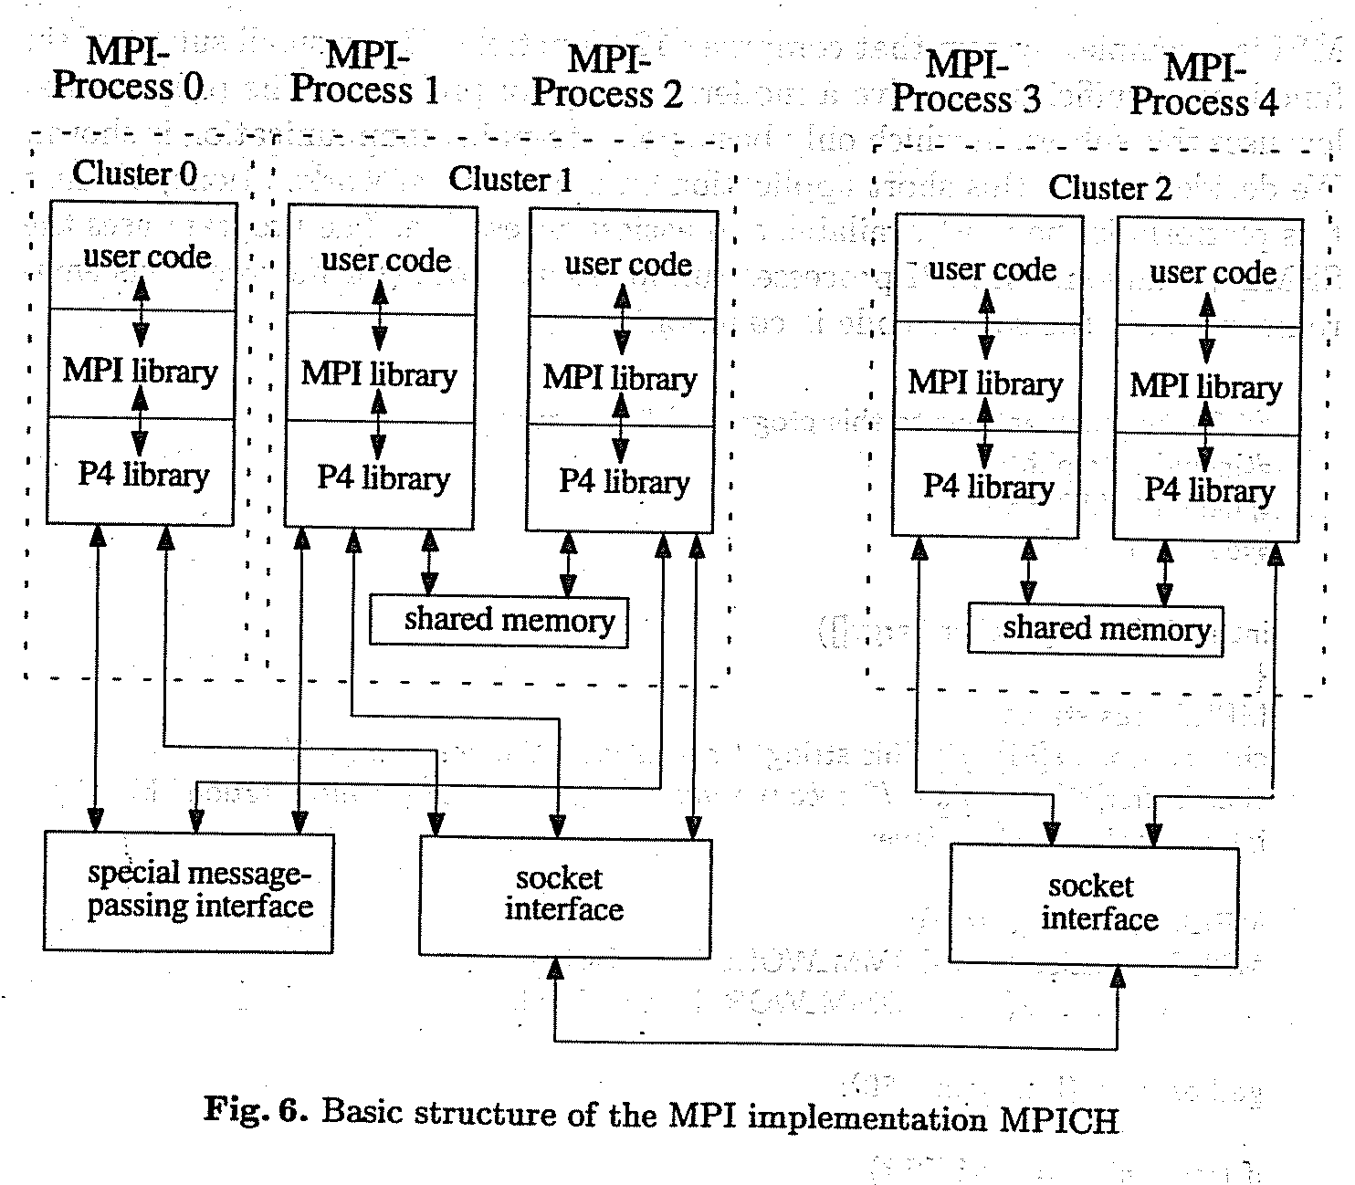

Slide 9
What is included in MPI?
Point to point communication
Collective operations
Process groups
Communication contexts
Process topologies
Bindings for Fortran77 and C
Environmental Management and inquiry
Profiling interface.

Slide 10
What does the standard exclude?
Explicit shared memory operations
Support for task management
Parallel I/O functions

Slide 11
MPI says “hello world”
MPI is a complex system that comprises 129 functions.
But a small subset of six functions is sufficient to solve a moderate range of problems!
The hello world program uses this subset.
Only a basic point-to-point communication is shown.
The program uses the SPMD paradigm.
Similar to SIMD
All MPI processes run identical codes.

Slide 12
The details of compiling this program depend on the systems you have.
MPI does not include a standard for how to start the MPI processes.
Under MPICH, the best way to describe ones own parallel virtual machine is given by using a configuration file, called a process group file.
On a heterogeneous network, which requires different executables, it is the only possible way. The process group file contains the machines (first entry), the number of processes to start (second entry) and the full path of the executable programs.

Slide 13
Example process group file hello.pg
Sun_a 0 /home/jennifer/sun4/hello
Sun_b 1 /home/jennifer/sun4/hello
Ksr1 3 /home/jennifer/ksr/ksrhello
Suppose we call the application hello, the process group file should be named hello.pg.
To run the whole application it suffices to call hello on workstation sun_a, which serves as a console.
A start-up procedure interprets the process group file and starts the specified processes.
sun-_a > hello

Slide 14
The file above specifies five processes, one on both Sun workstations and three on a KSR1 virtual shared memory multiprocessor machine.
By calling hello on the console (in this case, sun_a), one process group file contains as number of (additional) processes the entry zero to start on every workstation just one process.

Slide 15
This program demonstrates the most common method for writing MIMD programs. Different processes, running on different processors, can execute different program parts by branching within the program based on an identifier. In MPI, this identifier is called rank.

Slide 16
MPI framework
The functions MPI_Init() and MPI_Finalize() build the framework around each MPI application.
MPI_Init() must be called before any other MPI function may be used.
After a program has finished its MPI specific part, the call of MPI_Finalize() take care for a tidy clean up. All pending MPI activities will be canceled.

Slide 17
Who am I, How many are we?
MPI processes are represented by a rank.
The function MPI_Comm_rank() returns this unique identifier, which simply is a nonnegative integer. (number of processes_1)
To find out the total number of processes, MPI provides the function MPI_Comm_size().
Both MPI_Comm_rank() and MPI_Comm_size() use the prameter MPI_COMM_WORLD, which marks a determined process scope, called a communicator.

Slide 18
The communicator concept is one of the most important of MPI and distinguishes this standard from other message passing interfaces.
Communicators provide a local name space for processes and a mechanism for encapsulating communication operations to build up various separate communication “universes”.
That means a pending communication in one communicator never influences a data transfer in another communicator.
The initial communicator MPI_COMM_WORLD contains all MPI processes started by the application.

Slide 19
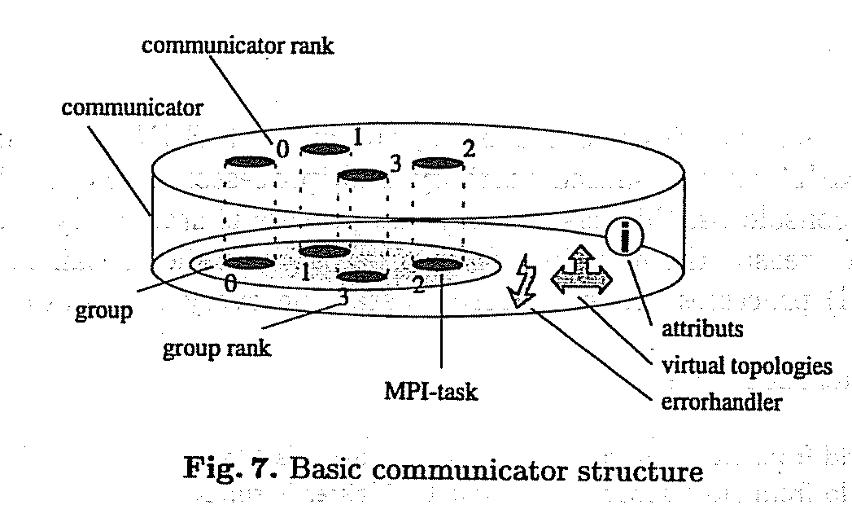

Slide 20
In a transferred sense, it would be possible to consider a communicator as a cover around a group of processes.
A communication operation always specifies a communicator.
All processes involved in a communication operation have to be described by their representation on the top side of the cover (communicator rank).

Slide 21
There are some other MPI concepts such as virtual topologies and user defined attributes, which may be coupled to a communicator.
MPI doesn’t support a dynamic process concept.
After start up MPI provides no mechanism to spawn new processes and integrate them into a running application.

Slide 22
Sending/Receiving Messages
An MPI message consists of a data part and a message envelope.
The data part is specified by the first three parameters of MPI_Send()/MPI_recv() which describe the location, size and datatypes which correspond to the basic data types of the supported languages.
In the example, MPI_CHAR is used which matches with Char in C.
The message envelope describes destination, tag and communicator of the message.
The tag argument can be used to distinguish different types of messages.

Slide 23
By using tags, the receiver can select particular messages.
In this example the master, which is process zero, sends his host name to all other processes, called slaves.
The slaves receive this string by using MPI_Recv().
After communication is finished, all processes print their “Hello World” that appear on the MPI console (Host sun_a)

Slide 24
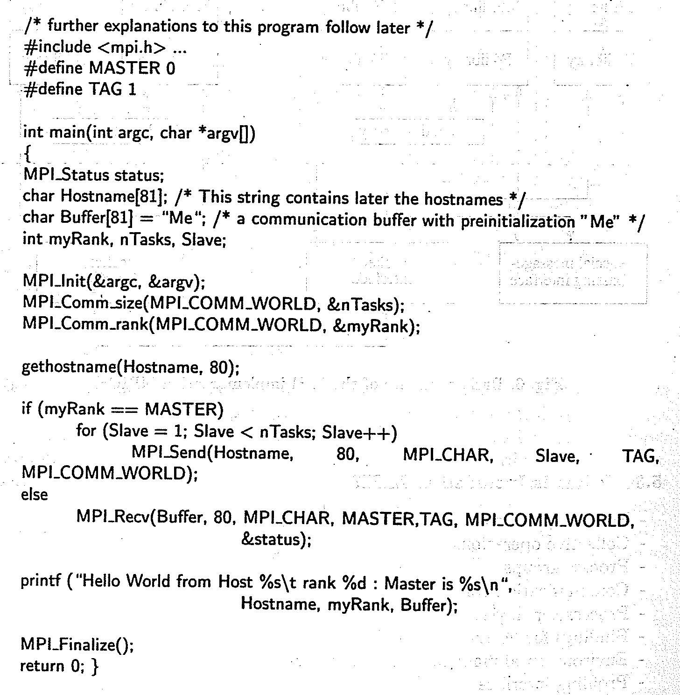

Slide 25
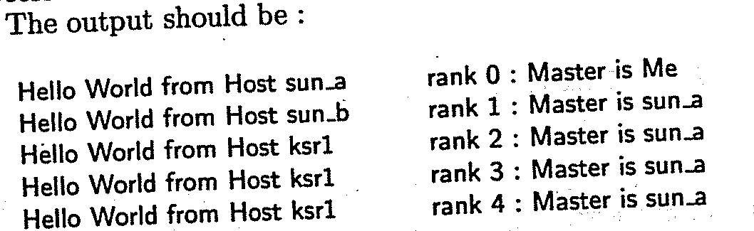

Slide 26
Running parallel jobs on clusters
* This is a 45-nodes cluster formed by DELL R720/R620 servers.
* It is divided into 2 sub-clusters (zone0 & zone1)
* Zone0 contains 20 nodes (z0-0...z0-19) interconnected by Infiniband (QDR)
* Zone1 contains 25 nodes (z1-0...z1-24) interconnected by Infiniband (QDR)
* Memory installed : 32GB on 40nodes (z0-0~z1-19), 64GB on 4nodes (z1-20~23), 96GB on 1node (z1-24)
* Head Node: cluster.phy.cuhk.edu.hk (137.189.40.13)
* Storage Node : 60TB (User's disk quota: /home/user/$user 500MB, /home/scratch/$user 500GB)
* Use department computer account ID and Password to logon
* Home directory/Disk Quota are independent from other dept. workstations
* OS : Rocks 6.1 (CentOS)
* MPI : MVAPICH2 2.0a (mpirun_rsh mpirun mpiexec)
* Compilers : mpicc mpicxx mpic++ mpif77 mpif90
* Queueing : TORQUE + MAUI (qsub qstat qhold qrls qdel)
* hostfile : $PBS_NODEFILE

Slide 27
Hostname Remarks
----------------------------------------------------------------------
cluster Head Node, DELL R720, 64G_RAM
nas Storage Node, DELL R720, 64G_RAM, 60TB_Storage
z0-0 ... z0-19 Zone0 Compute Nodes (20 nodes), 32G_RAM, Queue: zone0
z1-0 ... z1-19 Zone1 Compute Nodes (20 nodes), 32G_RAM, Queue: zone1
z1-20 .. z1-23 Zone1 Compute Nodes (4 nodes), 64G_RAM, Queue: zone1, bigmem
z1-24 Zone1 Copmute Nodes (1 node), 96G_RAM, Queue: zone1, bigmem
----------------------------------------------------------------------
** All nodes equipped Two Intel Xeon E5-2670 2.6GHz 8-Core (2 threads per core) CPUs
(i.e. 32 threads per node)

Slide 28
Quick User Guide
================
* SSH Login cluster.phy.cuhk.edu.hk or 137.189.40.13 using your dept. account
* Compile your MPI source code using : mpicxx mpicc mpic++ mpif77 mpif90
* Create a Job Script
* Submit your program to queue by "qsub"
Example :
============================================================================================
cluster > mpicc -o myjob myjob.c ## Compile your program first
Create a job script for queueing, say "myjob.sh", like below :

Slide 29
#!/bin/bash
#PBS -S /bin/bash ## many Torque PBS directives can be found on internet
#PBS -o myjob.out ## (optional) std. output to myjob.out
#PBS -e myjob.err ## (optional) std. error to myjob.err
#PBS -l walltime=01:00:00 ## request max. 1 hour for running
#PBS -l nodes=2:ppn=32 ## run on 2 nodes and 32 processes per node
#PBS -q zone1 ## (optional) queue can be zone0,zone1(default),bigmem
cd $PBS_O_WORKDIR ## change to current directory first
echo "Start at `date`" ## (optional) count the time used
cat $PBS_NODEFILE ## (optional) list the nodes used for this job
mpirun -hostfile $PBS_NODEFILE ./myjob ## run myjob on 2 nodes * 16 proc/node
echo "End at `date`" ## (optional) found in myjob.out
--------------------------------------------------------------------------------------------
cluster > qsub myjob.sh ## Submit myjob into default queue
88.cluster.local ## Job id in the queue
cluster > qstat ## check all MY jobs status, show details : qstat -f job_id
cluster > qstat -Q ## check how many jobs Run/Queued by all users
cluster > qdel 88 ## use qhold/qrls/qdel to hold/release/delete job

Slide 30
Remarks :
1. Determine which queue you use (default is zone1),
2. Nodes used cannot exceed the total number of available nodes
(i.e. You can't set ppn > 32, and if you use queue bigmem, you can't set nodes > 5)
3. ALL jobs submitted to nodes manually but not via "qsub" WILL BE KILLED automatically ****

